Slide 1
London Trip The Royal Opera House
Wednesday 7th December
7.15am-7.00pm

Slide 2
Foxwood Academy Core Values
Learning for Life
Independence
Education
Celebration

Slide 3
The Nutcracker
Foxwood Academy will be visiting The Royal Opera House
The Royal Opera House is situated in Covent Garden in London
We will be watching a performance of The Nutcracker performed by The Royal Ballet accompanied by a full orchestra
Notes:
Consider talking about:
Prehistory
Roman London
Anglo-Saxon and Viking period London
Middle Ages
Early modern
Late modern and contemporary

Slide 4
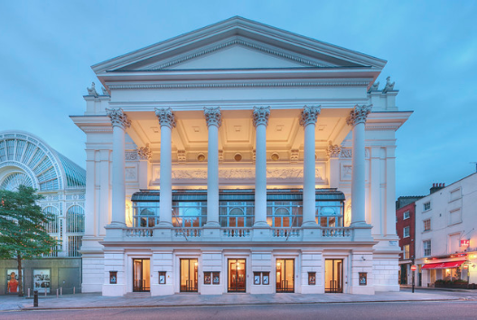
Where?
Notes:
Consider talking about:
Prehistory
Roman London
Anglo-Saxon and Viking period London
Middle Ages
Early modern
Late modern and contemporary

Slide 5
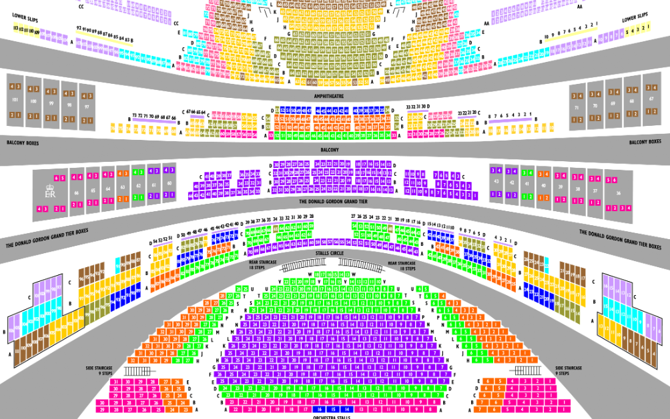
Where?
Notes:
Consider talking about:
Prehistory
Roman London
Anglo-Saxon and Viking period London
Middle Ages
Early modern
Late modern and contemporary

Slide 6
Who?
This is a whole school trip
There are currently around 80 students who are attending
Staff from Foxwood will accompany students
Hammonds Coach will take us in 3 x 52 seater coaches
There is a toilet on the coach and a service station stop will be made available if required
Notes:
Consider talking about:
Prehistory
Roman London
Anglo-Saxon and Viking period London
Middle Ages
Early modern
Late modern and contemporary

Slide 7
Who?
First aiders and medication will be taken and administered as usual on the trip
Students will be grouped with familiar or class based staff where possible
Notes:
Consider talking about:
Prehistory
Roman London
Anglo-Saxon and Viking period London
Middle Ages
Early modern
Late modern and contemporary

Slide 8
When?
Wednesday 7th December
Coaches will leave at 7.30am
We will arrive in London at 11.30am (or before)
Lunch and walk around Covent Garden
Performance starts at 12.30pm
Notes:
Consider talking about:
Prehistory
Roman London
Anglo-Saxon and Viking period London
Middle Ages
Early modern
Late modern and contemporary

Slide 9
When?
Return journey begins at approximately 3pm
We anticipate we will arrive back at around 7pm
Text updates will be sent on the day
Your child will need packed lunch and some food for evening meal
Letter will be sent out on Friday with confirmation of school dinner arrangement. Evening meal will need to be provided by home.
Notes:
Consider talking about:
Prehistory
Roman London
Anglo-Saxon and Viking period London
Middle Ages
Early modern
Late modern and contemporary

Slide 10
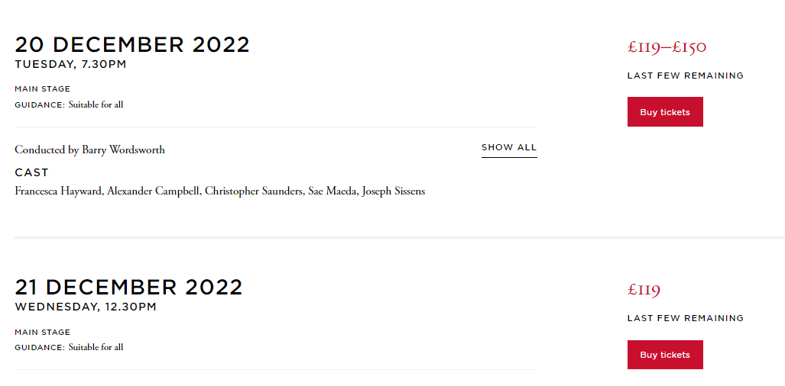
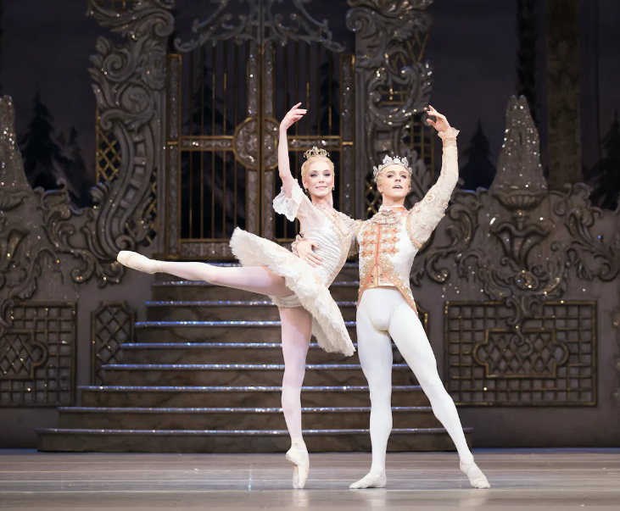
Questions?
Notes:
Consider talking about:
Prehistory
Roman London
Anglo-Saxon and Viking period London
Middle Ages
Early modern
Late modern and contemporary

